Slide 1


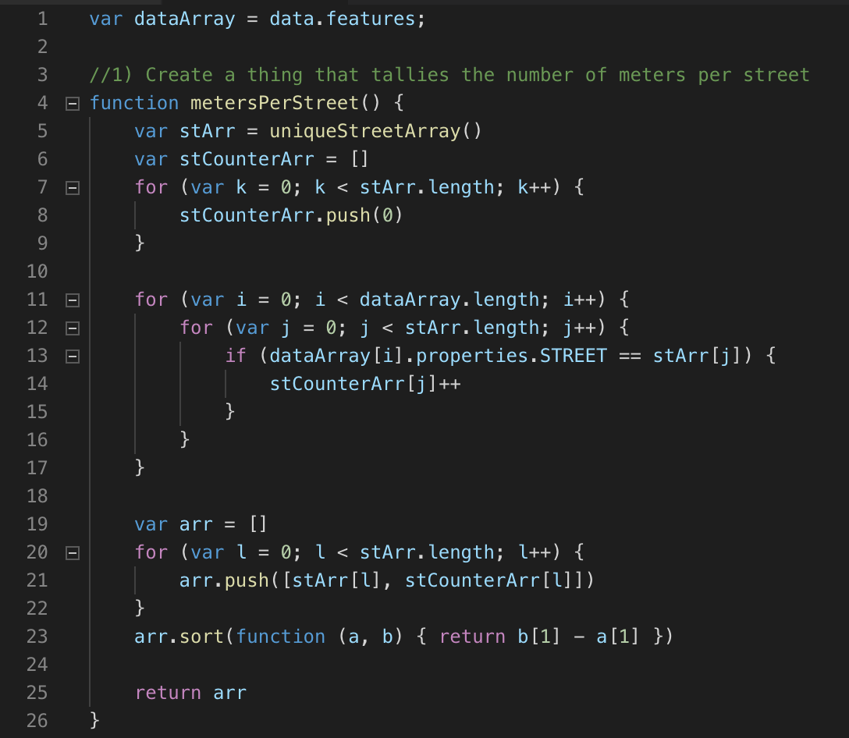
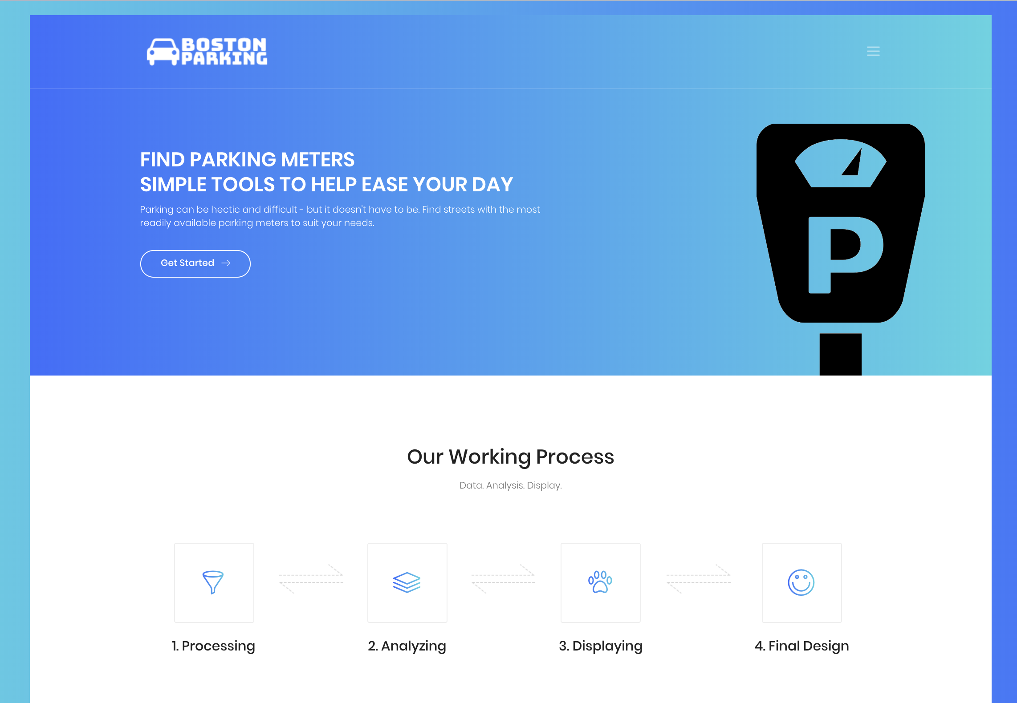
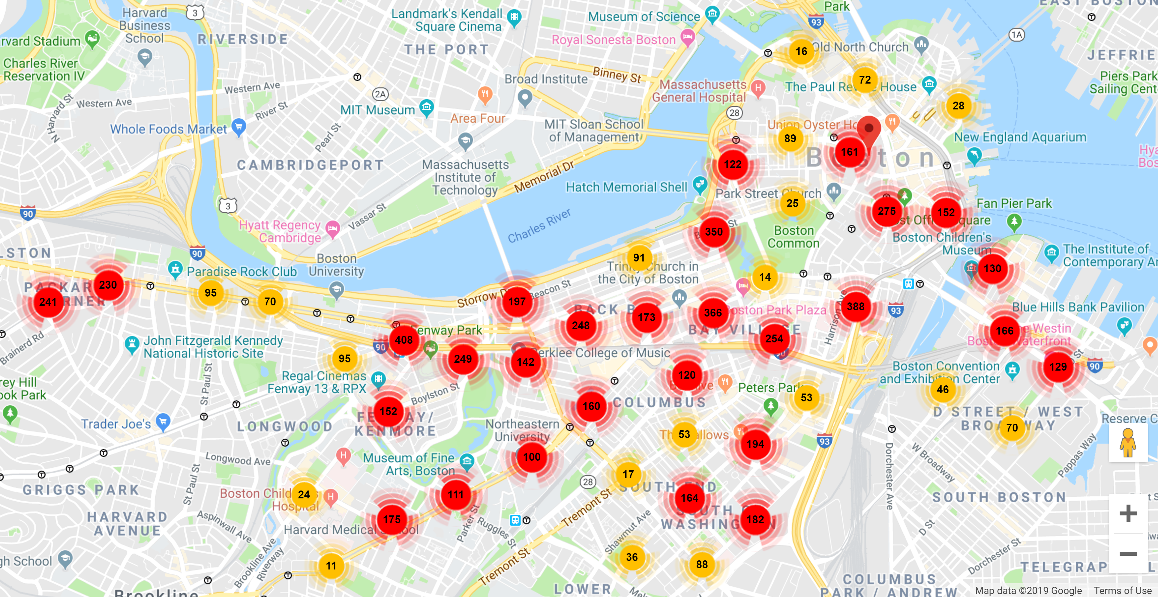
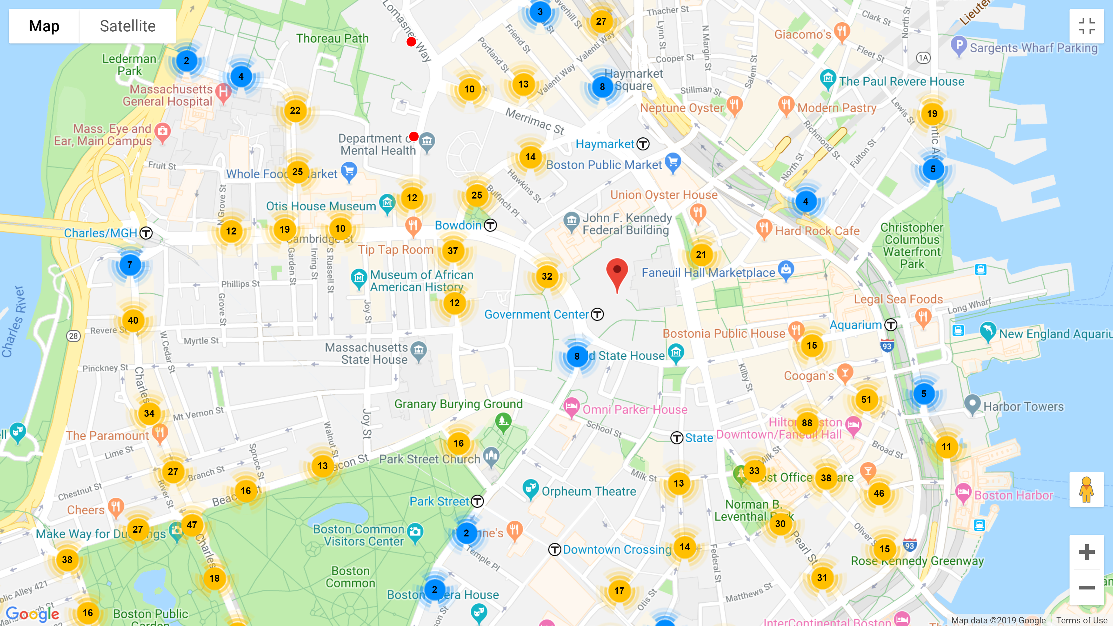
Boston, Big Data, and Web Technologies
Creation of Useful Data
The raw parking data was a JavaScript file that keyed attributes of parking meters in a large list. However, this data was meaningless until extracted. As such, our team coded in JavaScript to extract meaning full statistics such as counts, averages, and modes. Not all the data was entirely useful to a user, so the team used their discretion to select which of their created numbers and charts would be most essential.
ABSTRACT
EXTRACT DATA
Finished Website
INTERACTIVE MAP
After all of the data was incorporated into the main website, it had to be manipulated for aesthetics. Hence, html and css were used to adapt various features and make them more visually stimulating.
Manipulation of a Template
After downloaded a template in the form of a collection of html, css, and scss files, it had to be manipulated to suit to the team’s needs. Each page required generation of a new html page and adaptation of the text and appearance, most of which involved coding in html.
EXPLAIN DATA
Anna
I worked on much of the front end development of the website. However, I first gained insight into JavaScript syntax by sorting through the data, often making use of counters and for loops, and producing useful stats, such as the number of streets on which there was parking. From there, it was my job to create a html page with google charts of some of the key findings. This page was not the final product. The final product was the website. As such, much of my work involved taking code and incorporating aspects thereof into a new html using direct references, some direct copying, and other methods. The result was a template overridden with our data. The tail-end of the project was a time consuming process involving the design of the website, which required understanding the css.
Incorporation of Map
After the charts, statistics, and introductory pages were included, the portion of the team working on the creation of the main feature of the website – the interactive map - uploaded their work to GitHub and the Map was tastefully incorporated into the website framework.

